Slide 1
ASU’s Audio Visual Events Management Service:
From Zoom Bomber to Zoom Whisperer; Facilitating Engaging Virtual Meetings
Part II .
Seth Levine
Manager
Engagement & IT Service Delivery
Seth.Levine@asu.edu
Antonio Diaz
Systems Analyst
UTO AV Events
adiaz@asu.edu
Shayne Pomrenke
Systems Support Specialist
UTO AV Events
shayne.pomrenke@asu.edu

Slide 2
Contents
Intro
UTO AVEM Service Explained (again)
Zoom Meetings and Webinars
Live Streaming
Breakouts, Polling, Reactions
Engaging Methods (and madness)
VirBELA
Questions?
Notes:
Here’s what I have in mind to talk about. [read list] It really is a lot to cover and I want to leave time for your questions and discussion, so let’s get crackin’.

Slide 3
UTO Audio Visual Events Management
Equipment Rental/Loan
Classroom VC Support
AVEM Staffing
Simple/Standard Events with Zoom
Advanced Video/Conference Production Events
Advanced Guest Speaker/Panelist Events
Management of Outsourcing

Slide 4
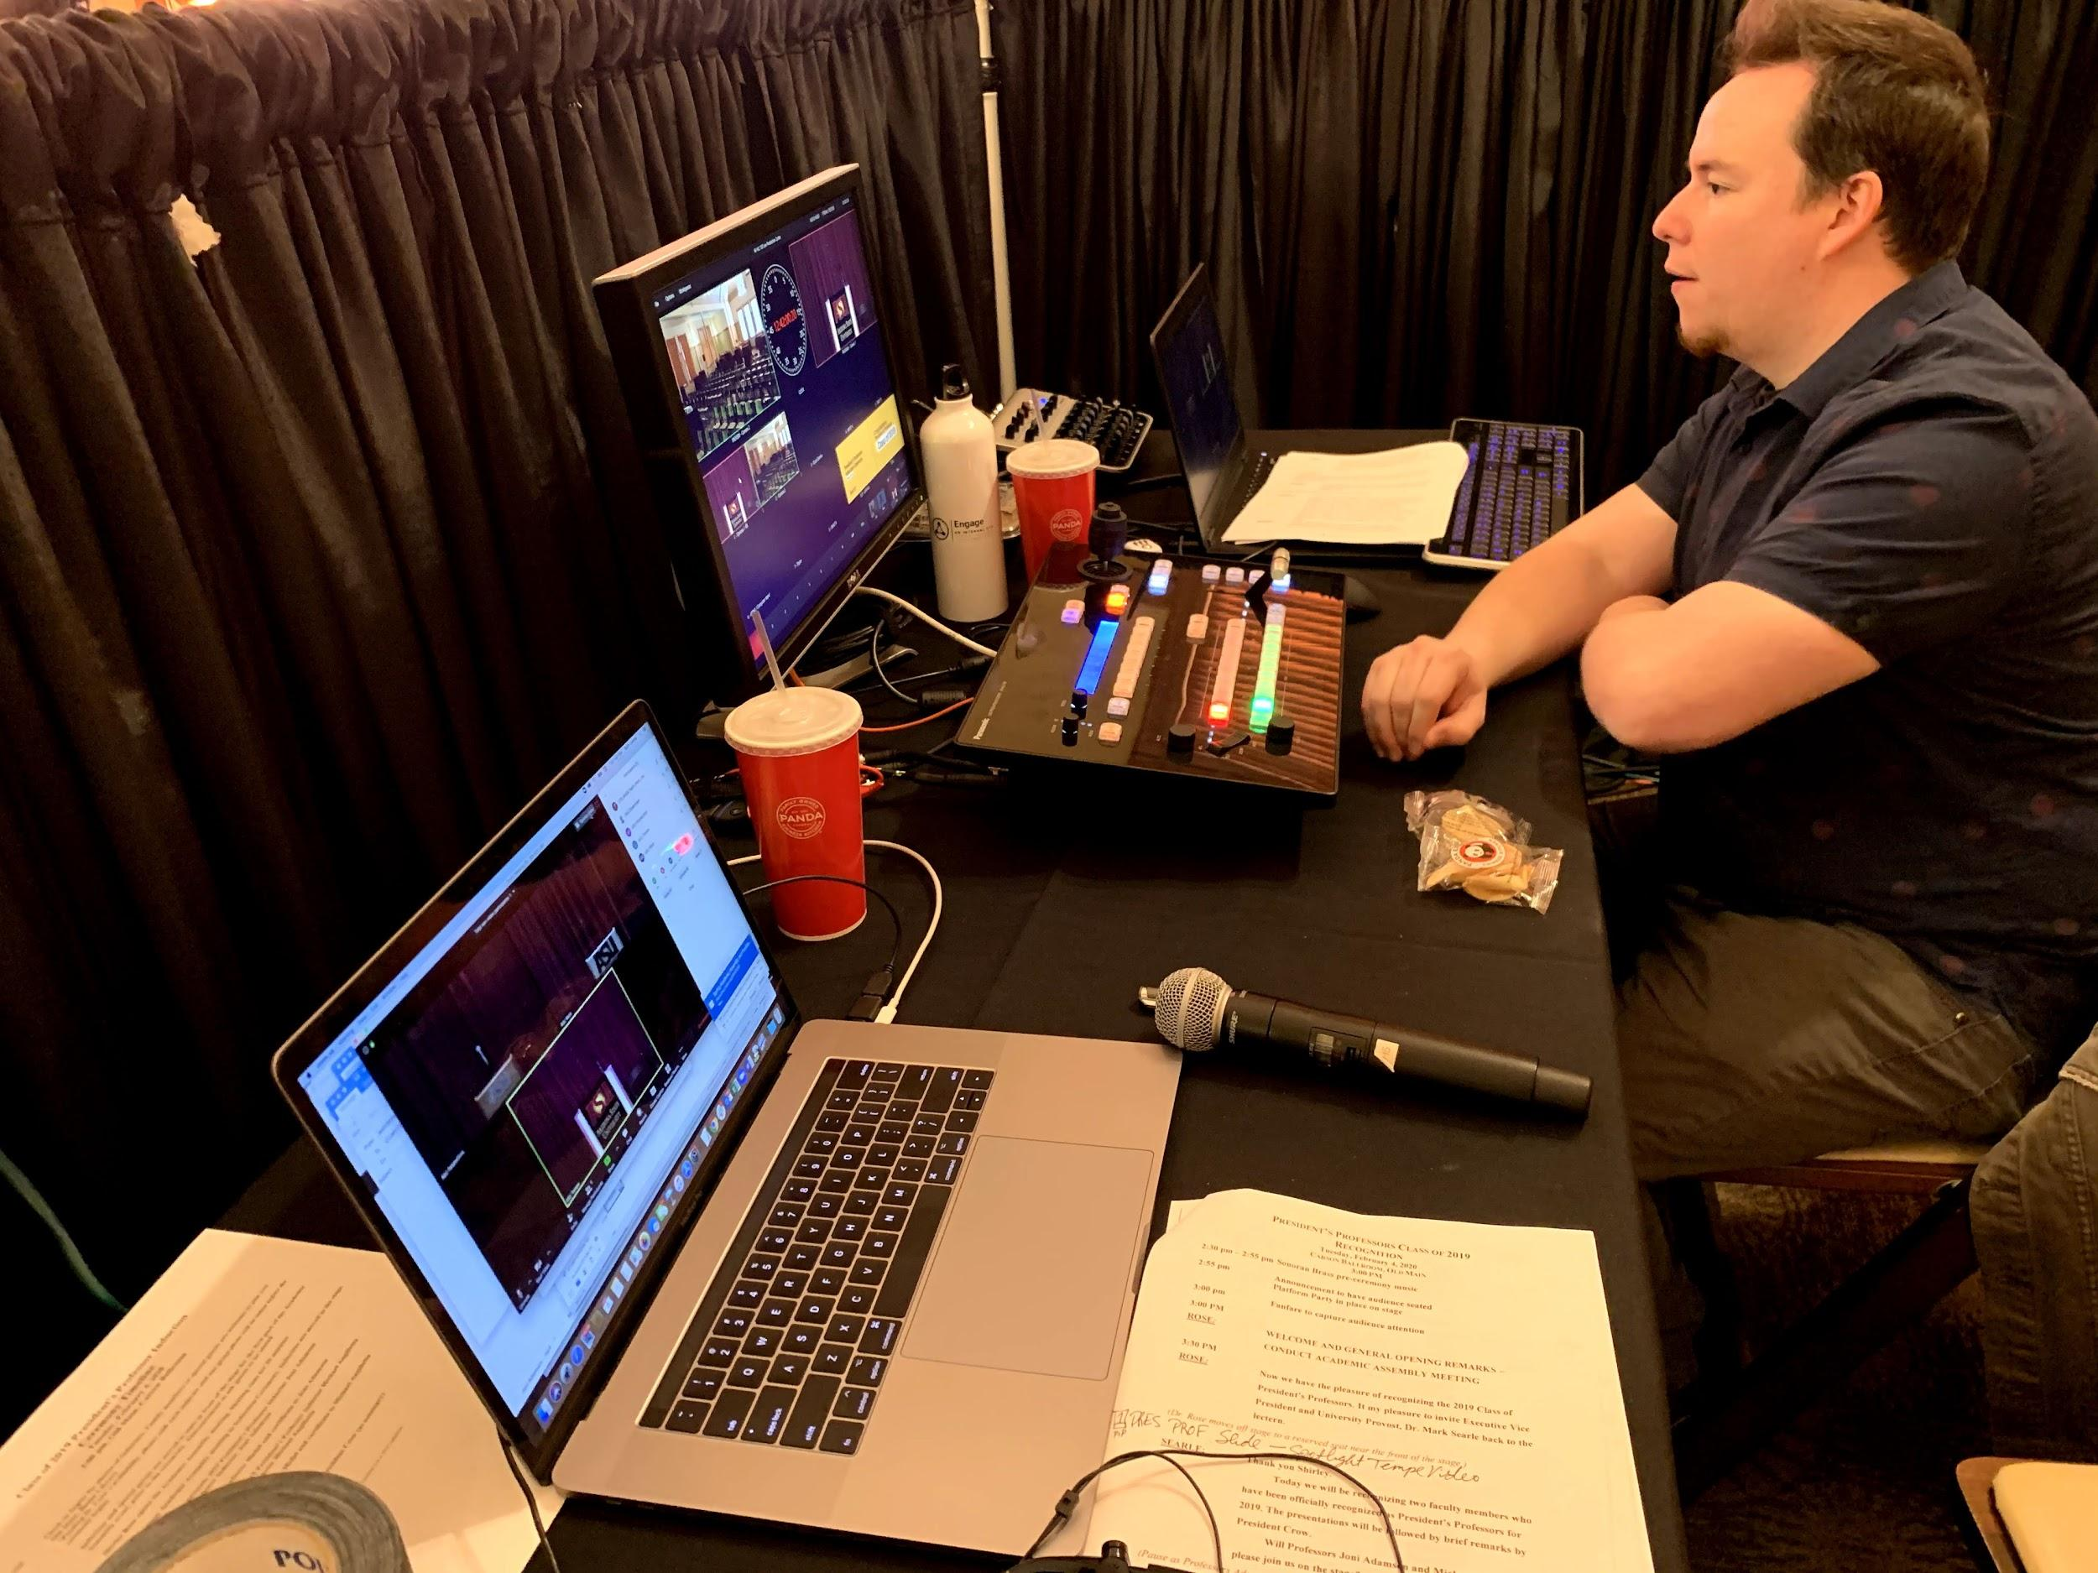
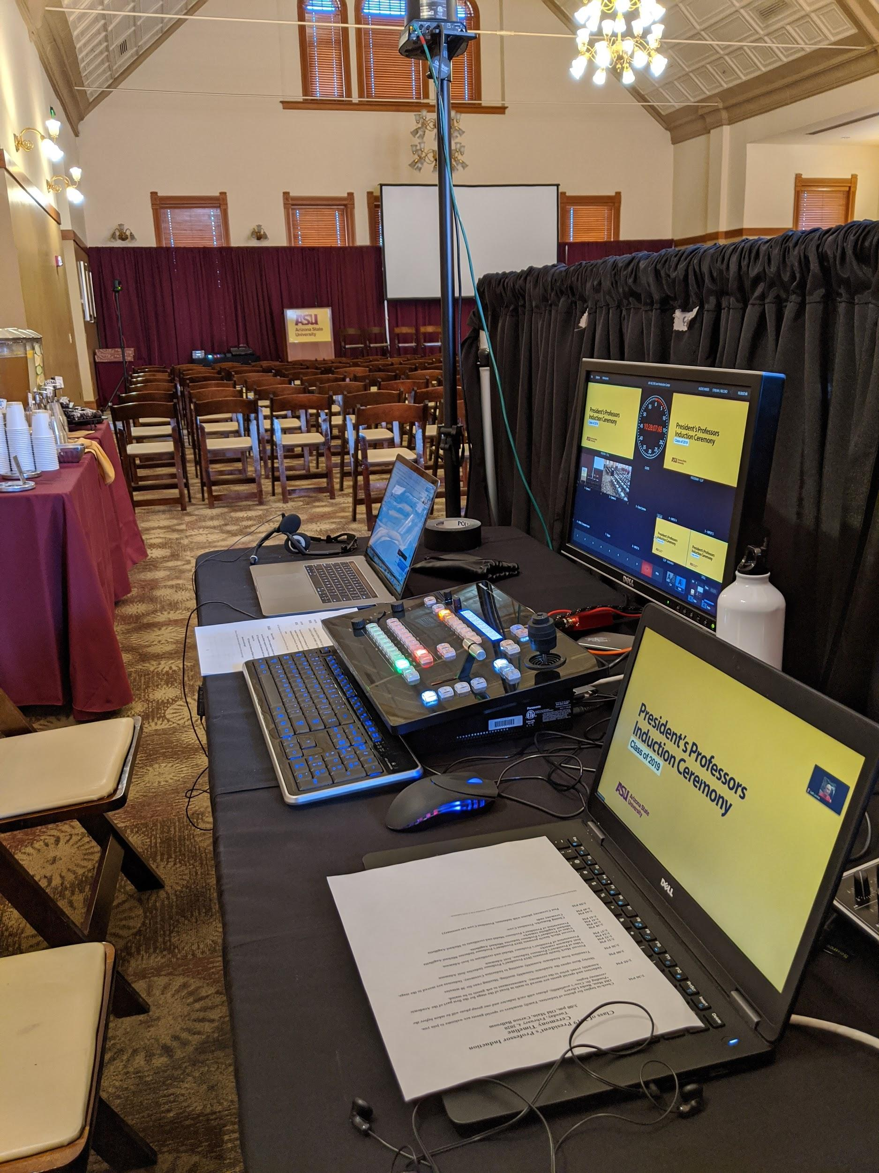
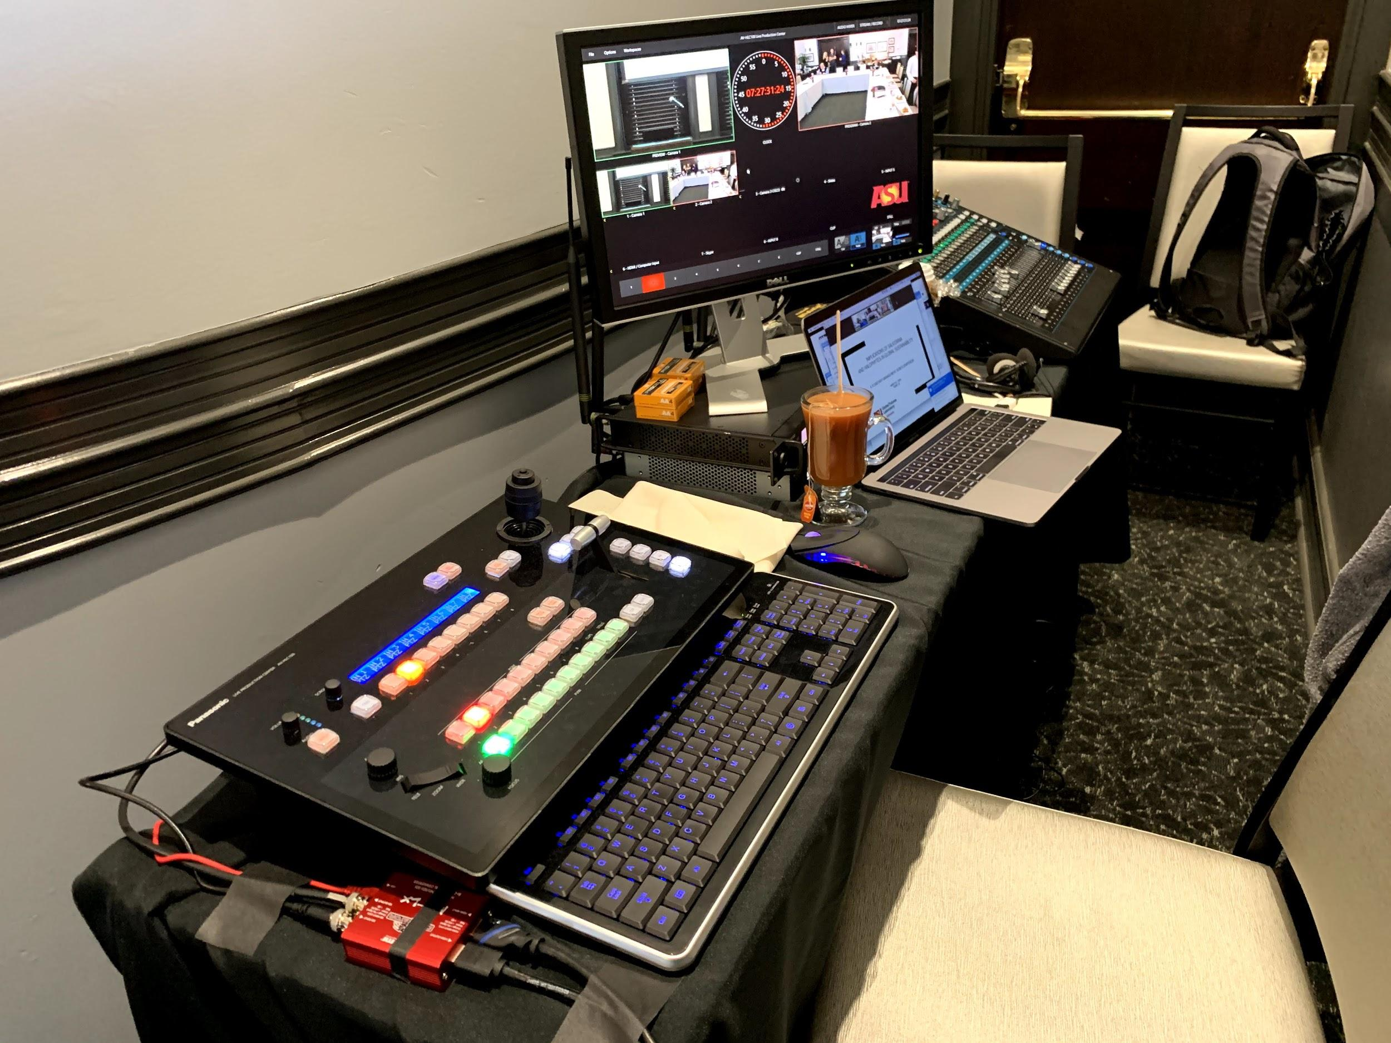
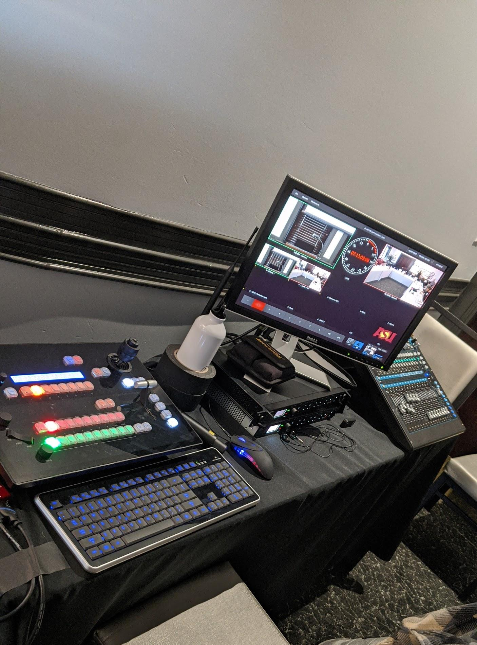
UTO Audio Visual Events Management

Slide 5
Meeting, Webinar or Live Stream?
Meetings provide a fully interactive collaboration environment. This format allows you to connect with attendees, create breakout rooms, run polls, see and hear all the attendees.
Webinars are a lecture style format with a lower interactivity component. Chat, Q&A & polling offer a way to get feedback and stay connected, while presenting a one (or few)-to-many event.
Live Streaming is a great way to distribute your event to larger groups on platforms that almost all Internet users can view from any web browser. This format is one way, and can be added to any Zoom Meeting or Webinar.
Registration Both Zoom Meetings AND Webinars offer a registration option. Consider this before deciding how you will keep track of your attendees.
Notes:
Amazon IVS

Slide 6
Breakouts, Polling, Reactions
Breakouts create sub-meetings to allow for group discussion, consensus building, directed conversations, social interactions, etc. Only the Host can manage Breakouts, and some features are not yet implemented.
Polling can be setup in advance or on-the-fly to ask multiple-choice or multiple-answer questions. This helps to keep the audience engaged, especially if they know a topic-based ‘quiz’ is coming up, and helps you guage whether or not they understood or were paying attention.
Reactions Clapping Hands, Thumbs up, Heart, Tears of Joy, Open Mouth, Party Popper, Hand-raises, Yes, No, Slower, Faster, Coffee Break...
Virtual Backgrounds, Frames and Filters Create a unified look for presenters and add fun elements

Slide 7
Trivia Quiz Using Mentimeter
Please visit:
http://www.menti.com and use the code 27 02 31

Slide 8
Bingo Using BingoBaker
Please visit:
https://bingobaker.com/play/43dfd380d263a060

Slide 9
Wheel Of Names
Get ‘em in early and keep ‘em til the end with
https://wheelofnames.com/

Slide 10
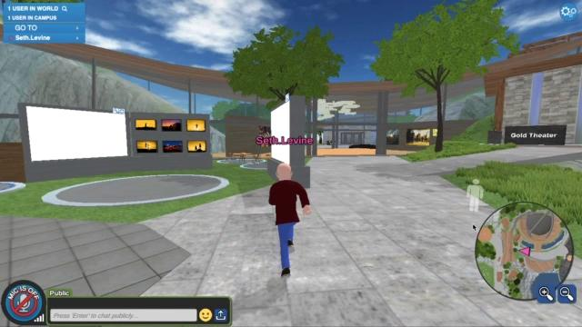
VirBELA - The Gamification of, well, Everything!
http://links.asu.edu/VirBELASignup

Slide 11
Engage the UTO AVEM Team!
We are available via:
Service Now (Video Conference)
Email; videoconf-q@asu.edu
Slack (any one, two, or all three of us)
Don’t go it alone! We are professionals and have more than likely seen and done what you have in mind!

Slide 12
Many Thanks.
Questions?
Seth Levine | Seth.Levine@asu.edu
Antonio Diaz | adiaz@asu.edu
Shayne Pomrenke | Shayne.Pomrenke@asu.edu

